Slide 1
7 things which you should care about before release your code to production
Mateusz Dymiński
Nokia

Slide 2
Whoami
Mateusz Dymiński
Software Developer at Nokia
7+ exp with Java
3+ exp with Go
One of the organizer GoWroc - Golang Wroclaw Meetup
Github: github.com/mateuszdyminski
Twitter: @m_dyminski
LinkedIn: linkedin.com/in/mdyminski

Slide 3
Agenda
Versioning
Profiling
Health checks
Logs
Performance
Monitoring and alarming
Release process

Slide 4


Slide 5
Versioning

Slide 6
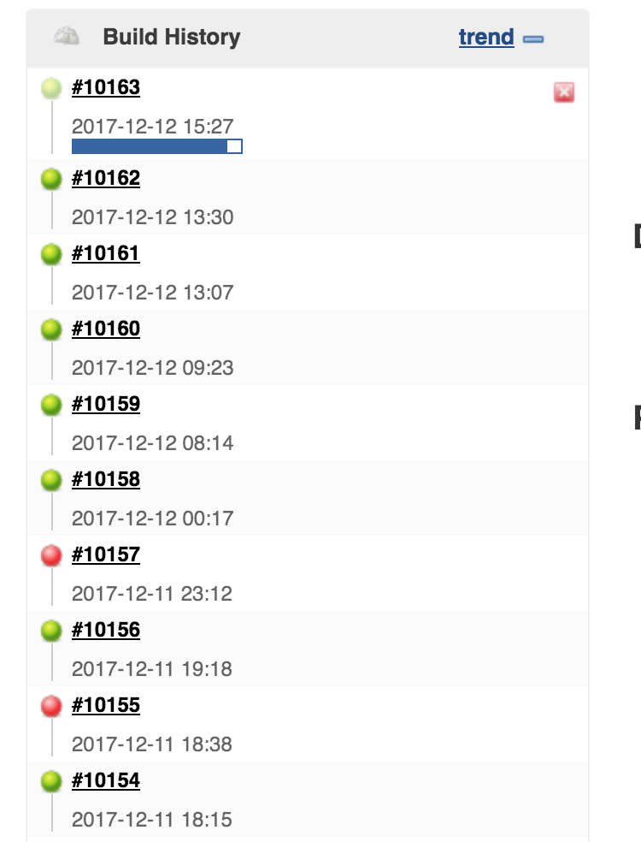

Slide 7
Version Builds

Slide 8
Version Builds - Problem
Which version had the bug? Is that deployed already?
If you use git repository you may want to know exactly what changeset is currently deployed.
git tag is not enough

Slide 9
Version Builds
Add information about the build at build time.
Version
Last commit
Build time
Env vars

Slide 10
Version Builds - how to
Use maven/gradle plugin to add information about build
https://github.com/ktoso/maven-git-commit-id-plugin

Slide 11
Version Builds - usage
<plugins> <plugin> <groupId>pl.project13.maven</groupId> <artifactId>git-commit-id-plugin</artifactId> <version>2.2.2</version> <executions> <execution> <id>get-the-git-infos</id> <goals> <goal>revision</goal> </goals> </execution> <execution> <id>validate-the-git-infos</id> <goals> <goal>validateRevision</goal> </goals> <phase>package</phase> </execution> </executions> </plugin> </plugins>

Slide 12
Version Builds – git.properties
#Generated by Git-Commit-Id-Plugin #Mon Oct 02 21:46:11 CEST 2017 git.build.user.email= git.build.host=Mateuszs-MBP git.dirty=true git.remote.origin.url=https://mateuszdyminski@github.com/mateuszdyminski/7things-java.git git.closest.tag.name= git.commit.id.describe-short=a0c6481-dirty git.commit.user.email=dyminski@gmail.com git.commit.time=03.07.2017 @ 08:57:23 CEST git.commit.message.full=Cleanup README.md git.build.version=1.0-SNAPSHOT git.commit.message.short=Cleanup README.md git.commit.id.abbrev=a0c6481 git.branch=master git.build.user.name= git.closest.tag.commit.count= git.commit.id.describe=a0c6481-dirty git.commit.id=a0c6481a4c796a010adfe41a8f24577911125122 git.tags= git.build.time=02.10.2017 @ 21:46:11 CEST git.commit.user.name=Mateusz Dyminski

Slide 13
Version Builds
How to load properties file in injection method:
private GitRepositoryState getGitRepositoryState() { try { Properties properties = new Properties(); properties.load(getClass().getClassLoader().getResourceAsStream("git.properties")); return new GitRepositoryState(properties); } catch (IOException e) { throw new RuntimeException(e); } }
And REST controller:
@Path("health") public class HealthResource { @Inject private GitRepositoryState gitRepositoryState; @GET @Produces("application/json") public Response getHealth() { return Response.ok().entity(new HealthStatus(gitRepositoryState)).build(); } }

Slide 14
Version Builds - demo
http://localhost:8090/health

Slide 15
Version artifacts

Slide 16
Version artifacts
Always store build results.
Options:
Nexus, ftp, etc.
Github, Bitbucket, Codeplex
Dockerhub, private Docker registry

Slide 17
Version artifacts - Maven
mvn deploy:deploy-file -Durl=file://~\m2-repo \ -DrepositoryId=some.id \ -Dfile=your-artifact-1.0.jar \ [-DpomFile=your-pom.xml] \ [-DgroupId=org.some.group] \ [-DartifactId=your-artifact] \ [-Dversion=1.0] \ [-Dpackaging=jar] \ [-Dclassifier=test] \ [-DgeneratePom=true] \ [-DgeneratePom.description="My Project Description"] \ [-DrepositoryLayout=legacy] \ [-DuniqueVersion=false]

Slide 18
Version artifacts - Docker
<plugin> <groupId>com.spotify</groupId> <artifactId>docker-maven-plugin</artifactId> <configuration> <imageName>my-image</imageName> ... </configuration> <executions> <execution> <id>build-image</id> <phase>package</phase> <goals> <goal>build</goal> </goals> </execution> <execution> <id>tag-image</id> <phase>package</phase> <configuration> <image>my-image</image> <newName>registry.example.com/my-image</newName> </configuration> </execution> </executions> </plugin>

Slide 19
Version artifacts - Docker
To push image to registry:
$ mvn clean package docker:build -DpushImageTag

Slide 20
Version artifacts - GitHub
Tool for GitHub release automation:
https://github.com/aktau/github-release
To push artifacts to GitHub:
$ github-release upload \ --user mateuszdyminski \ --repo 7things \ --tag v0.1.0 \ --name "7things" \ --file bin/darwin/7things

Slide 21
Version API

Slide 22
Version REST API
Three common approach:
http://company.com/api/v2/users
http://company.com/api/users
http://company.com/api/users
GET v2.0/users Accept: application/json
GET /users Accept: application/vnd.usersapp-v2+json
GET /users x-app-version: 2.0

Slide 23
Version REST API
http://company.com/api/v2/users
Code:
GET v2.0/users Accept: application/json
@Path("/api") public class UsersPrefixResource { @GET @Path("/v{version}/users") @Produces("application/json") public Response getUsers(@PathParam("version") String version) { if (version.equalsIgnoreCase("1")) { return Response.ok().entity(Arrays.asList(new User("Jan", "Kowalski"))).build(); } else { return Response.ok().entity( Arrays.asList(new User("Jan", "Kowalski", "987654321"))).build(); } } }

Slide 24
Version REST API
Demo
http://localhost:8180/api/v1/users
VS
http://localhost:8180/api/v2/users

Slide 25
Version REST API
http://company.com/api/users
Code:
GET /users Accept: application/vnd.usersapp-v2+json
@Path("users") public class UsersResource { @GET @Produces("application/vnd.usersapp-v1+json") public Response getUsersV1() { User user = new User("Jan", "Kowalski"); return Response.ok().entity(Arrays.asList(user)).build(); } @GET @Produces("application/vnd.usersapp-v2+json") public Response getUsersV2() { User user = new User("Jan", "Kowalski", "987654321"); return Response.ok().entity(Arrays.asList(user)).build(); } }

Slide 26
Version REST API
Demo
curl http://localhost:8180/users curl -H "Accept: application/vnd.usersapp-v1+json" http://localhost:8180/users curl -H "Accept: application/vnd.usersapp-v2+json" http://localhost:8180/users

Slide 27
Version Static Content

Slide 28
Version Static Content
Reduce the risk that client gets cached-old files.
Three most popular approaches:
/statics/$REVISION/app.js
/statics/app.js?v=$REVISION
/statics/app.$REVISION.js

Slide 29
Version DB Schema

Slide 30
Version DB Schema
Versioning a database means document all changes of a database schema.
DB migration tools allow to:
Recreate a database from scratch
Make it clear at all times what state a database is in
Migrate in a deterministic way from your current version of the database to a newer one

Slide 31
Version DB Schema
Most popular DB migration tools:
Flyway
Liquibase
Migrate
Custom solution

Slide 32
Version DB - Liquibase example
changelog.sql
it also might be xml, yaml, json
--liquibase formatted sql --changeset mdyminski:1 dbms:mssql --comment create users table create table users ( id int primary key, name varchar(255) ); --rollback drop table users; --changeset mdyminski:2 dbms:mssql --comment alter table users - add new field alter table users add phone nvarchar (255) NULL; --rollback ALTER TABLE users DROP COLUMN phone;

Slide 33
Version DB - Liquibase example
Supported commands: migrate, validate, diff, sql
liquibase --changeLogFile=changelog.sql --driver=com.microsoft.sqlserver.jdbc.SQLServerDriver --classpath=jdbc/sqljdbc4-4.0.jar --url="jdbc:sqlserver://mydb.db.windows.net:1433;database=some-db" --username=some-user --password=some-password update

Slide 34
Profiling

Slide 35
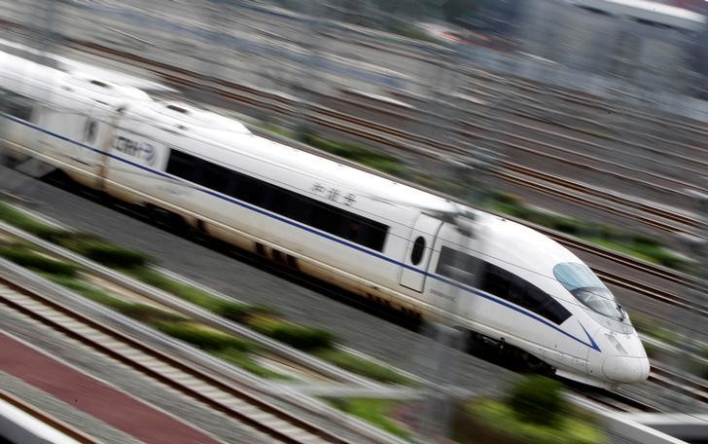

Slide 36
Profiling
Rules:
Don’t overengineering!
Be sure that you can profile your app anytime!
Profile your app at least once before go live!

Slide 37
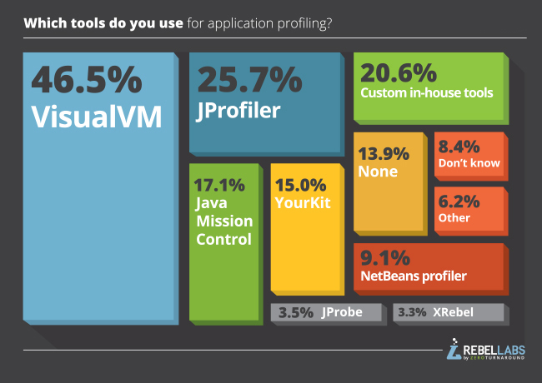
Profiling

Slide 38
Profiling
To enable remote access to our Java app add flags:
Don't forget about the firewall/security policy!
-Dcom.sun.management.jmxremote -Dcom.sun.management.jmxremote.port=8011 -Dcom.sun.management.jmxremote.ssl=false -Dcom.sun.management.jmxremote.authenticate=false

Slide 39
Profiling
It’s not about the Profiling but…
Don’t forget about
-XX:+HeapDumpOnOutOfMemoryError -XX:HeapDumpPath=/some/place/for/dumps

Slide 40
Health Checks

Slide 41


Slide 42
Do I really need Health Checks ?

Slide 43
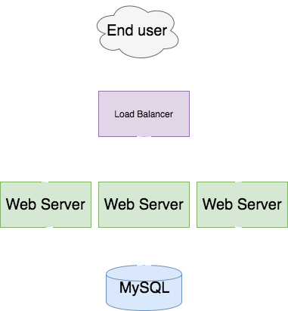

Slide 44
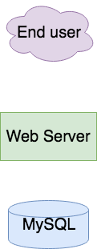
Do I need health checks in following architecture?

Slide 45
HealthZ
It leverage health endpoint pattern.
Historically comes from Google’s internal practices.
Adds many important information about the health of our service:
Deployed version
Uptime
Hostname
Git statistics
Health of external services - DB, Cache etc

Slide 46
Health Checks
Add AppStatus and Mongo client to Health REST controller:
Don’t forget about
@Path("api/health") public class ExtendedHealthResource { @Inject private GitRepositoryState gitRepositoryState; @Inject private MongoDatabase mongoDatabase; @Inject private AppStatus appStatus; @GET @Produces("application/json") public Response getHealth() { Document serverStatus = mongoDatabase.runCommand(new Document("serverStatus", 1)); return Response.ok().entity(new ExtendedHealthStatus(gitRepositoryState, serverStatus, appStatus)).build(); } }

Slide 47
Health Checks
AppStatus class:
Don’t forget about
public class AppStatus { private String hostname; private LocalDateTime startedAt; public AppStatus(String hostname, LocalDateTime startedAt) { this.hostname = hostname; startedAt = startedAt; } public String getHostname() { return hostname; } public String getStartedAt() { return StartedAt.toString(); } public String uptime() { return Duration.between(StartedAt , LocalDateTime.now()).toString(); } }

Slide 48
Health Checks
How AppStatus is injected:
Don’t forget about
private AppStatus getAppStatus() { String hostname = "Unknown"; try { InetAddress addr; addr = InetAddress.getLocalHost(); hostname = addr.getHostName(); } catch (UnknownHostException ex) { throw new RuntimeException(ex); } return new AppStatus(hostname, LocalDateTime.now()); }

Slide 49
DEMO
http://localhost:8090/api/health

Slide 50
Logs

Slide 51
Logs
Best practices:
Use structured logger
Log context of invocation
Use log aggregators
Log with error level should force user (administrator, or direct user) intervention!

Slide 52
Logs – example without context

Slide 53
Simple REST-based calculator:
@Path("calculator") public class Calculator { private static Logger logger = LogManager.getLogger(Calculator.class); @GET @Path("add") @Produces("text/plain") public String add(@QueryParam("val1") Integer val1, @QueryParam("val2") Integer val2) { if (val1 != null) { logger.info("Got val1: {}", val1); } if (val2 != null) { logger.info("Got val2: {}", val2); } int result = val1 + val2; logger.info("Result: {}", result); return format("Result of %d + %d = %d", val1, val2, result); } }

Slide 54
Logs
Test:
Result:
Logs:
curl 'http://localhost:8070/calculator/add?val1=3&val2=7'
Result of 3 + 7 = 10
[INFO] 22:31:54.649 LF.filter - HTTP REQUEST: GET /calculator/add Headers: {host=[localhost:8070], user-agent=[curl/7.47.0], accept=[*/*]} [INFO] 22:31:54.653 C.add - Got val1: 3 [INFO] 22:31:54.654 C.add - Got val2: 7 [INFO] 22:31:54.655 C.add - Result: 10 [INFO] 22:31:54.656 LF.filter - HTTP RESPONSE: GET /calculator/add Status: 200

Slide 55
Logs
Test:
Logs:
hey -n 100 -c 10 -H "Content-type: text/plain" "http://localhost:8070/calculator/add?val1=3&val2=7"
[INFO] 22:36:24.458 LF.filter - HTTP RESPONSE: GET /calculator/add Status: 200 [INFO] 22:36:24.458 C.add - Got val2: 7 [INFO] 22:36:24.459 C.add - Result: 10 [INFO] 22:36:24.459 LF.filter - HTTP RESPONSE: GET /calculator/add Status: 200 [INFO] 22:36:24.461 LF.filter - HTTP REQUEST: GET /calculator/add Headers: {host=[local… [INFO] 22:36:24.461 LF.filter - HTTP REQUEST: GET /calculator/add Headers: {host=[local… [INFO] 22:36:24.462 C.add - Got val1: 3 [INFO] 22:36:24.462 C.add - Got val2: 7 [INFO] 22:36:24.462 C.add - Got val1: 3 [INFO] 22:36:24.462 C.add - Result: 10 [INFO] 22:36:24.462 C.add - Got val2: 7 [INFO] 22:36:24.462 LF.filter - HTTP RESPONSE: GET /calculator/add Status: 200 [INFO] 22:36:24.463 C.add - Result: 10 [INFO] 22:36:24.463 LF.filter - HTTP RESPONSE: GET /calculator/add Status: 200

Slide 56
Logs – let’s add context

Slide 57
Create request context when HTTP request comes to app.
@PreMatching public class LoggingFilterWithCtx implements ContainerRequestFilter, ContainerResponseFilter { private static Logger logger = LogManager.getLogger(LoggingFilter.class); @Inject private Provider<Request> request; @Override public void filter(ContainerRequestContext requestContext) throws IOException { ThreadContext.put(REQUEST_ID, UUID.randomUUID().toString()); ThreadContext.put(REQUEST_IP, request.get().getRemoteAddr()); logger.info("HTTP REQUEST: {} /{} Headers: {}", requestContext.getMethod(), requestContext.getUriInfo().getPath(), requestContext.getHeaders()); } @Override public void filter(ContainerRequestContext requestContext, ContainerResponseContext responseContext) { logger.info("HTTP RESPONSE: {} /{} Status: {}", requestContext.getMethod(), requestContext.getUriInfo().getPath(), responseContext.getStatus()); ThreadContext.remove(REQUEST_ID); ThreadContext.remove(REQUEST_IP); } }

Slide 58
Logs
Test:
Logs:
hey -n 100 -c 10 -H "Content-type: text/plain" "http://localhost:8070/calculator/add?val1=3&val2=7"
[I] 22:39:16.19 98c3d2f1-815e216e0c63 [grizzly-11] 127.0.0.1 - HTTP RESPONSE: GET /calc… [I] 22:39:16.19 aab9e772-f9abdf62a129 [grizzly-9] 127.0.0.1 - Got val1: 3 [I] 22:39:16.19 aab9e772-f9abdf62a129 [grizzly-9] 127.0.0.1 - Got val2: 7 [I] 22:39:16.20 aab9e772-f9abdf62a129 [grizzly-9] 127.0.0.1 - Result: 10 [I] 22:39:16.19 a589072c-fa04f4fa2a3b [grizzly-12] 127.0.0.1 - Got val2: 7 [I] 22:39:16.20 a589072c-fa04f4fa2a3b [grizzly-12] 127.0.0.1 - Result: 10 [I] 22:39:16.20 aab9e772-f9abdf62a129 [grizzly-9] 127.0.0.1 - HTTP RESPONSE: GET…. [I] 22:39:16.20 9568307d-9ace8480f489 [grizzly-14] 127.0.0.1 - HTTP REQUEST: GET /cal… [I] 22:39:16.21 9568307d-9ace8480f489 [grizzly-14] 127.0.0.1 - Got val1: 3 [I] 22:39:16.22 9568307d-9ace8480f489 [grizzly-14] 127.0.0.1 - Got val2: 7 [I] 22:39:16.22 9568307d-9ace8480f489 [grizzly-14] 127.0.0.1 - Result: 10 [I] 22:39:16.22 9568307d-9ace8480f489 [grizzly-14] 127.0.0.1 - HTTP RESPONSE: GET /cal… [I] 22:39:16.21 29a0e614-d536ec677462 [grizzly-13] 127.0.0.1 - HTTP REQUEST: GET /calcu…

Slide 59
Logs – frontend

Slide 60
Logs - frontend
Backend might work but frontend not
Collect logs from Frontend!
Options
Use Sentry or similar tool
Add extra endpoint in the backend for logs from frontend - tricky and risky

Slide 61
Logs – log aggregators

Slide 62
Logs – log aggregators
Log aggregator > grep
Use log aggregator even for 1 node setup
Really simple to configure nowadays
Serious security problem

Slide 63




Logs – log aggregators
Options:

Slide 64
Logs – log aggregators – how to

Slide 65
Logs – ELK how to
Configure log4j to send logs to LogStash - old way
log4j.rootLogger=debug,tcp log4j.appender.tcp=org.apache.log4j.net.SocketAppender log4j.appender.tcp.Port=5000 log4j.appender.tcp.RemoteHost=localhost log4j.appender.tcp.ReconnectionDelay=10000 log4j.appender.tcp.Application=playground

Slide 66
Logs – ELK how to
Use http://www.fluentd.org/
<source> @type tail format apache tag apache.access path /var/log/httpd/access_log </source> <match var.log.containers.log**> type elasticsearch log_level info host elasticsearch-logging port 9200 logstash_format true num_threads 8 </match>

Slide 67
Logs – ELK how to
Use FileBeats https://www.elastic.co/products/beats/filebeat
# filebeat.yml filebeat: prospectors: - paths: - /var/log/your-app/app.*.log input_type: log output: logstash: hosts: ["your-logstash-host:5000"]

Slide 68

Performance

Slide 69
Performance
What to do before the release:
Run performance tests at least once and save the results.
Run stability tests at least once.
Don't forget to run them on environment similar to production.
This isn't as much of time consuming as many think.

Slide 70
Performance
Options:
http://gatling.io/
http://jmeter.apache.org/
https://github.com/tsenart/vegeta
https://github.com/rakyll/boom / https://github.com/rakyll/hey

Slide 71
Performance - report
Run:
Logs:
hey -c 10 -n 1000 http://localhost:8090/api/health
Summary: Total: 4.1074 secs Slowest: 0.2727 secs Fastest: 0.0353 secs Average: 0.0389 secs Requests/sec: 243.4658 Status code distribution: [200] 1000 responses Response time histogram: 0.035 [1] | 0.059 [969] |∎∎∎∎∎∎∎∎∎∎∎∎∎∎∎∎∎∎∎∎∎∎∎∎∎∎∎∎∎∎∎∎∎∎∎∎∎∎∎∎ 0.083 [24] |∎ 0.107 [5] | 0.130 [0] | 0.154 [0] | 0.178 [0] | 0.202 [0] |

Slide 72
Monitoring and Alarming

Slide 73


Slide 74
Monitoring and Alarming
Monitoring should never require a human to interpret any part of the alerting domain
Three valid kinds of monitoring output
Alerts: human needs to take action immediately
Tickets: human needs to take action eventually
Logging: no action needed

Slide 75
Monitoring and Alarming
Eliminating toil - Carla Geisser:
“If a human operator needs to touch your system during normal operations, you have a bug. The definition of normal changes as your systems grow.”
If you have to ssh to your server to do some work - something is wrong
Automate backups
Automate logs rotating - send old ones to S3/equivalent

Slide 76
Monitoring and Alarming
Measure everything
Set alerts based on the metrics
Analytics can use your metrics!

Slide 77
Monitoring and Alarming
Key things to measure
Java GC metrics
Http code rates
Http response time percentiles - 50, 95, 99
Error logs
Uptime
Business metrics
IPC(instructions per cycle) over CPU - CPU utilization is wrong

Slide 78







Monitoring and Alarming
Options:

Slide 79
Monitoring – sample integration
Register Librato client:
Send some metrics:
MetricRegistry registry = environment.metrics(); Librato.reporter(registry, "<Librato Email>", "<Librato API Token>") .setSource("<Source Identifier (usually hostname)>") .start(10, TimeUnit.SECONDS);
Librato.metric(registry, "logins").tag("uid", uid).meter().mark() Librato.metric (registry, "kafka-read-latencies").tag("broker", broker).histogram().update(latency) Librato.metric(registry, "temperature").source("celcius").tag("type", "celcius").gauge(() -> 42)) Librato.metric(registry, "jobs-processed").source("ebs").meter().mark() Librato.metric (registry, "just-these-tags").tag('"foo", "bar").doNotInheritTags().timer.update(time)

Slide 80
Release Process

Slide 81

Release Time

Slide 82
Release Process
Before Release:
Create Release Notes
Create Release Plan
Create Release Process

Slide 83
Release Process
Release notes:
Manual list
Take it from JIRA
Take it from git/svn - git log v1.0..v1.2
Use sections - New and Fixed

Slide 84
Release Process
Release plan:
When release the application (time, day)
What if something goes wrong? Revert?
Release Trains ?
Release Window ?
Continuos release ?

Slide 85
Release Process
Automate everything:
Ansible/Puppet/Chef/Salt*
Docker/Kubernetes/Swarm
Sometimes bash is good enough : )
Use process daemons - Does my app be up & running when node will be rebooted?

Slide 86
Release Process
Extra features:
Graceful shutdown
Canary deployments
Rollout deployments - kubernetes

Slide 87


Slide 88
Thank you!

